Slide 1
BELL RINGER
WELCOME TO…
THE PEOPLE
V. MATSUMOTO

Slide 2
BELL RINGER
OBJECTIONS
Relevance
Hearsay
Opinion
Speculation
Leading Question

Slide 3
BELL RINGER
MEME ASSIGNMENT
Think about what we’ve learned during our mock trial about court cases, trials, crimes, or even the mock trial process itself.
Let’s put these lessons into meme form!

Slide 4
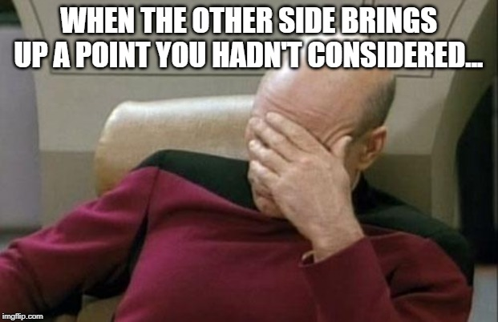
BELL RINGER
MEME ASSIGNMENT

Slide 5
BELL RINGER
MEME ASSIGNMENT
Go to imgflip.com/memetemplates
Come up with at least ONE meme that describe (in some way) something that you’ve learned during the mock trial process.
Post the meme to our class Edmodo page with a short explanation (at least one sentence) as your caption.

